Slide 1

Helping Bigbasket Customers Through Smarter Product Recommendations
ANLT-276: Emphasis Case Studies
Ali Taheri
Brandon Reynolds
Joe Jung

Slide 2
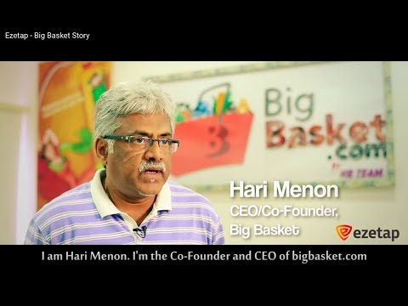
A Quick Message From CEO Hari Menon
Launched in December 2011
India’s largest online food and grocery store
Operating in 25 cities
Over 18,000 products and 1,000 brands
Average of 35,0000 of orders per day
Average 1 million + orders per month
Notes:
With the online grocery market expecting to grow at 55% CAGR over the next 4 years, we can only imagine these numbers will increase.

Slide 3
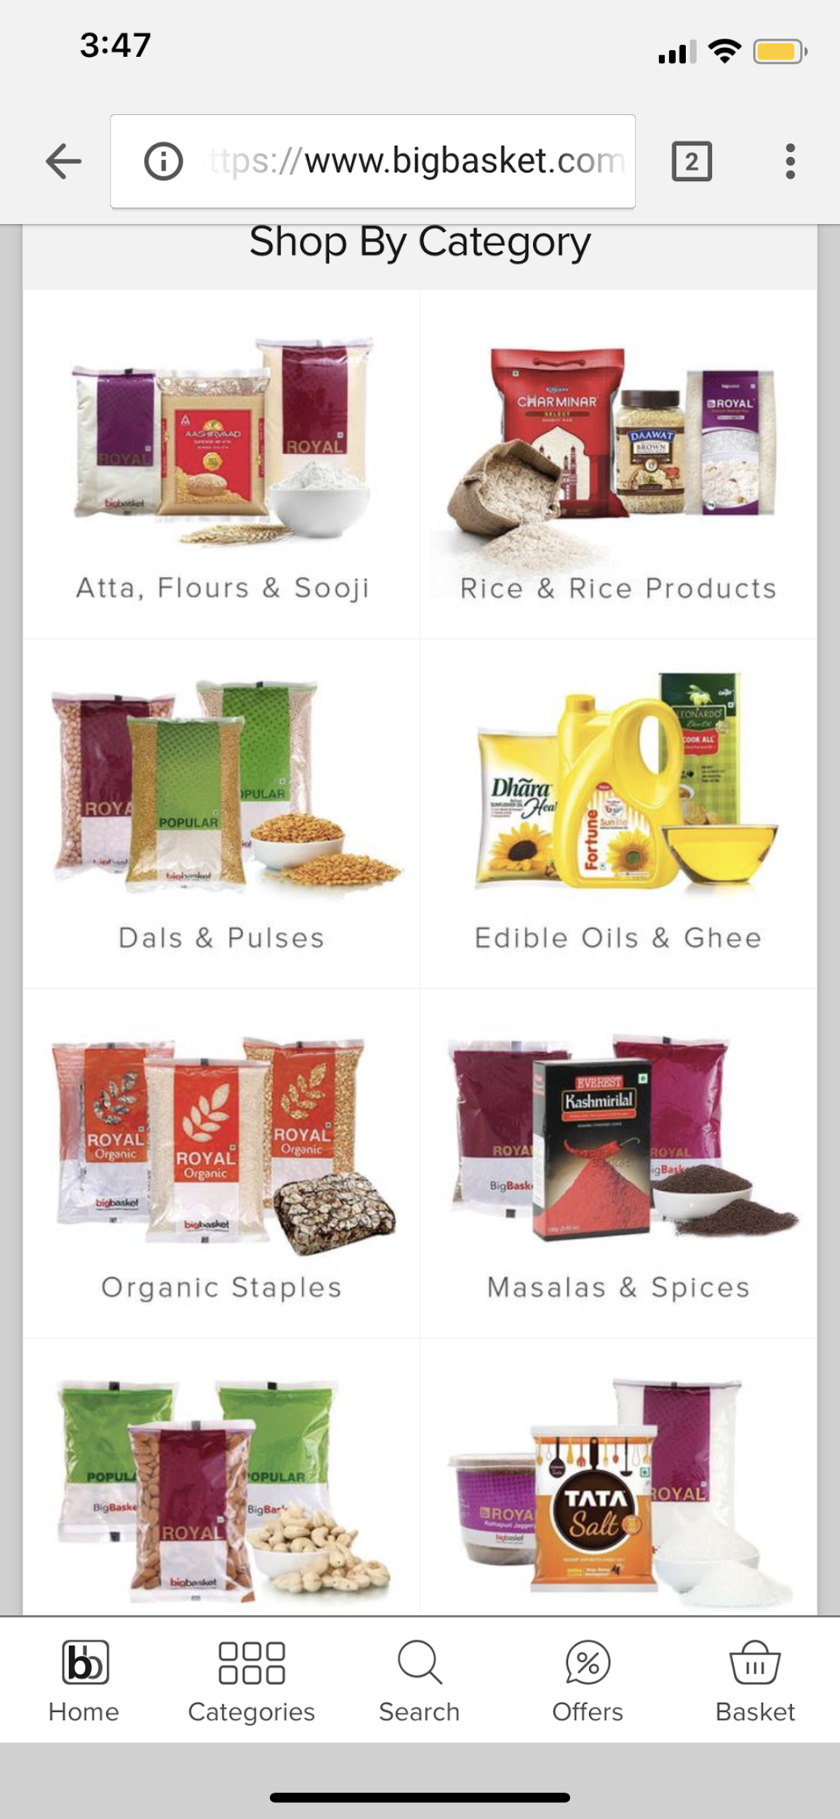
The Big Problem for Bigbasket
Range appears to be taken care of, but convenience could be an area for improvement
Customer’s checking out multiple times due to
Forgetfulness
Customers have to start a new order or even order elsewhere
Unorganized list of products
30% of customers order on mobile device
Finding products taking ~20-30 minutes
Notes:
India - subscription services
https://www.forbes.com/sites/abehal/2016/06/22/navigating-indias-tricky-ecommerce-subscription-waters/#59dfa0e36256

Slide 4
Business Implications of The Problem
Increased supply chain costs
Each order delivers separately
Multiple orders to same address cause redundancy in packaging, delivery time, etc..
Inefficient planning of headcount and resources
Decreased basket size
Preventable revenue loss due to forgetfulness and untidy shopping platform
Potential overstocking leads to revenue loss
Perishable items can go bad in the warehouse if not purchased
Inconsistent ordering makes inventory hard to predict or prepare for
Notes:
India - deliveries BEFORE rush hour (5-7am)

Slide 5
Hypothesis
We propose that a smarter recommendation system would help Bigbasket in the following ways:
Customers will forget to order products less
Customers might make more purchases based on recommendations
Supply chain costs will decrease due to less order volume
Reduced redundancy from less orders going to the same places
Improved predictability of resources within distribution centers
After implementing a smarter recommendation system, the ultimate goal would be to offer a subscription based model where customers spend less time and inventory is less at risk.
Notes:
Whether its inventory or headcount

Slide 6
Collaborative Filtering
Concept of Collaborative Filtering: If Alice loves A and B, and Bob loves A, B, and C, then Alice is more likely to love C!
Data can be thought of as a matrix, where:
Rows represent a customer
Columns represent a product
Data are customer ratings of products
3rd dimension - we propose a time difference (day or week) for subscription based model

Slide 7
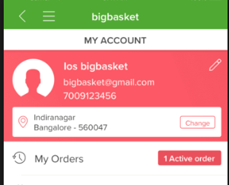
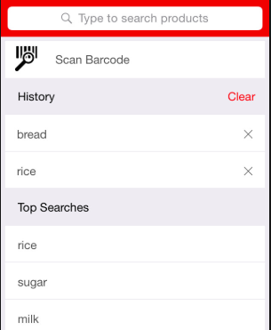
Sources of Data
Primary sources of data:
Purchasing history of user (~1 year)
Purchasing history of other users who have bought same product
Survey data asking customers for their rating of purchased products
Possible other sources:
Viewing Click/Search histories and frequencies
Duration spent viewing products
Search/purchase history outside of Bigbasket (if possible)
Notes:
Data > 1 year may skew consumer behavior

Slide 8
Preparing the Data for Collaborative Filtering
For filling matrix with rating of users for their purchased goods, we could do as below:
Sending survey list to users and ask them about level of their satisfaction by product.
Clustering users of a household and assigning average existing ratings of a product to Non-existing ones
Estimation of product rating by volume and frequency in purchase pattern of client (Repurchase rate)
Calculation similarity of products by methods same to Cosine and Pearson
Finding patterns in observed selection behavior ( item ratings) across community of users
Predict new preferences based on those patterns

Slide 9
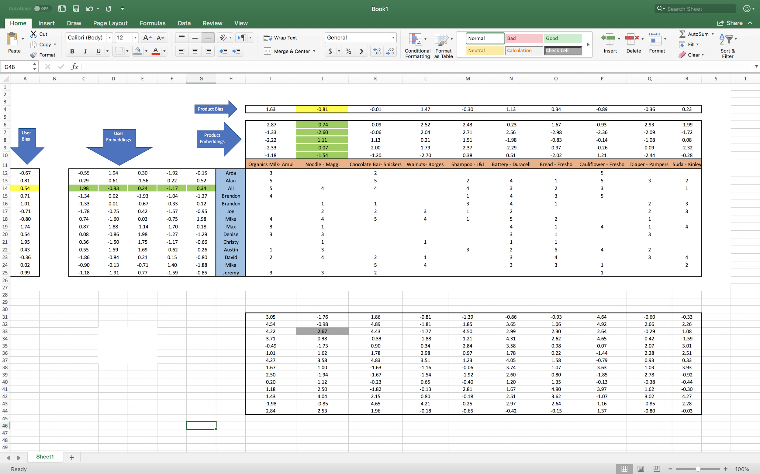
Using the Data
We need a Matrix with rows as Users and columns as Products
Each element of Matrix shows satisfaction of user from product in a scale of 0 to 5
Obviously some items are blank and our main problem is prediction of those blank spots

Slide 10
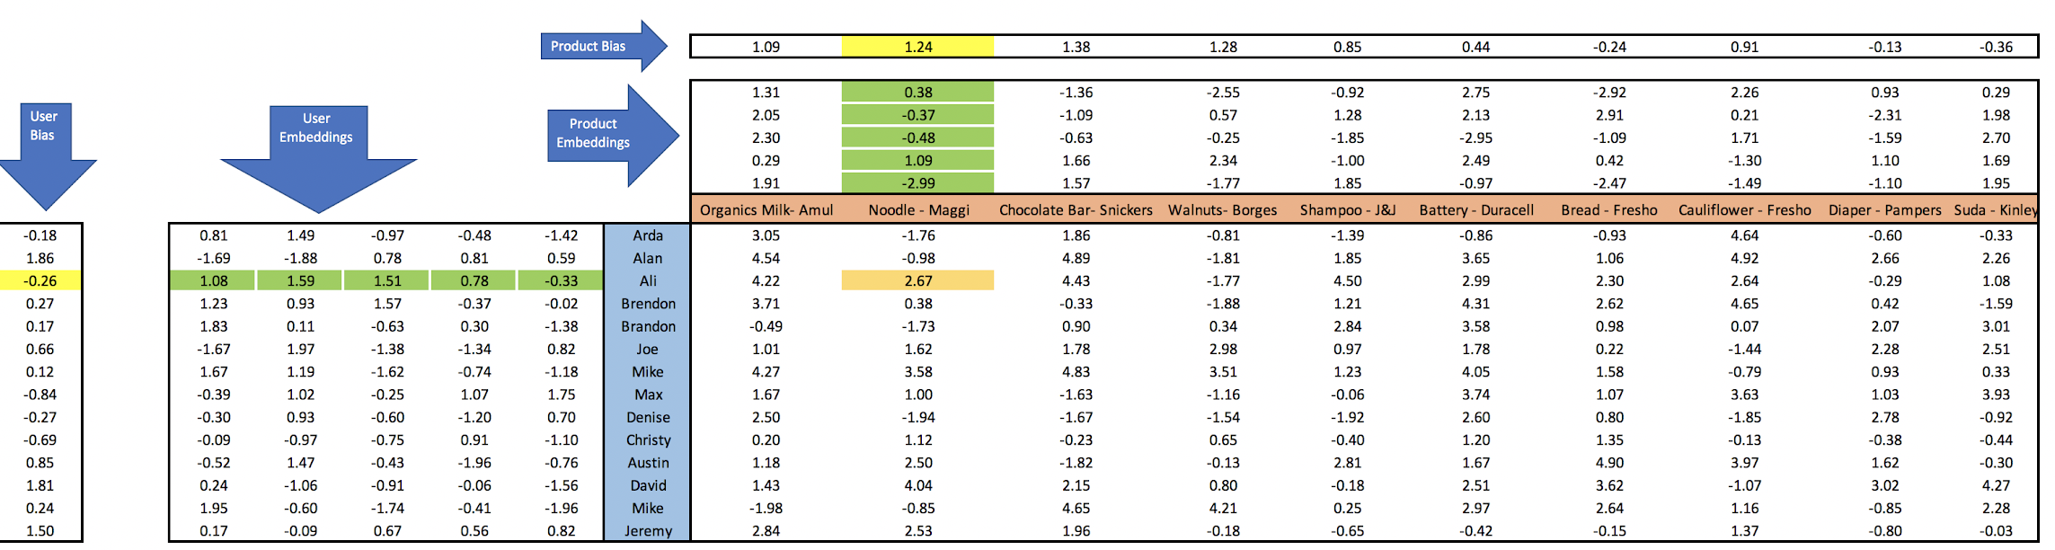
Recommendation System Model
Now we would have: Predicted rating = Embedding vector dot product (user, product) + user bias + product bias
Embeddings is capturing different characteristics of the entity it is representing
We could offer products with the highest predicted ratings to individual clients.
Notes:
We could calculate all of them with Gradient Descent for minimizing total RSME.
It’s time to find User bias, Product bias and Embedded Vectors of users and products.

Slide 11
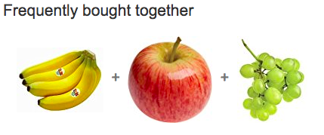
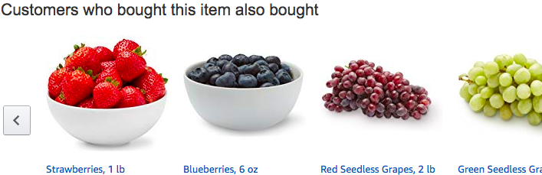
Proposed Results from Model
The proposed model for recommendations will appear to the user as a list of items that other customers have bought.
These products will be products that other people have bought in combination with the item being looked at.

Slide 12

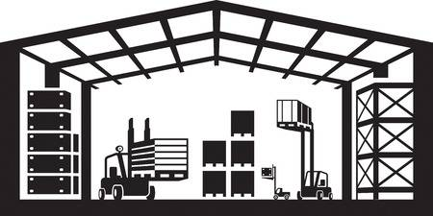

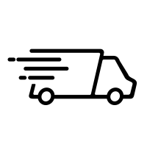


An Improved Bigbasket Model
Revenue
Costs

Slide 13
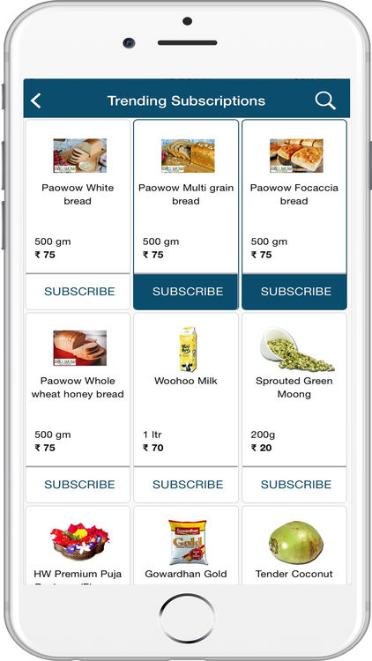
Big Future for Bigbasket
Bigbasket has recently taken an important step towards improving the shopping experience of their customers through the acquisition of RainCan
A subscription-based e-grocery startup
Hopes to improve micro-delivery services of essential household items.
Also recently acquired a stake in a business called Kwik24, which sets up smart vending machines for fresh produce.
Currently in talks to merge with their main competitor in order to better compete with Amazon and other popular retailers.

Slide 14
Resources
https://economictimes.indiatimes.com/opinion/interviews/predictability-a-challenge-in-subscription-model-hari-menon-ceo-bigbasket/articleshow/60214720.cms
https://www.exchange4media.com/marketing-news/the-biggest-challenge-is-to-get-the-supply-chain-rightmarketing-headbigbasket-89507.html
https://economictimes.indiatimes.com/small-biz/startups/amazon-in-talks-to-buy-indian-online-grocer-bigbasket/articleshow/59130524.cms
https://economictimes.indiatimes.com/small-biz/startups/grocery-startups-subscription-based-services-may-prove-cost-efficient/articleshow/60214386.cms
https://www.youtube.com/watch?v=RYTbIrjrJyM&t=0m30s
http://www.kwik24.com/
https://www.thenewsminute.com/article/3-acquisitions-bigbasket-now-offer-micro-delivery-vending-kiosks-and-more-90286
https://towardsdatascience.com/collaborative-filtering-and-embeddings-part-1-63b00b9739ce
https://www.vccircle.com/bigbasket-buys-raincan-to-boost-micro-delivery-business

